Slide 1

Analog Signals
&
Digital Signals

Slide 2
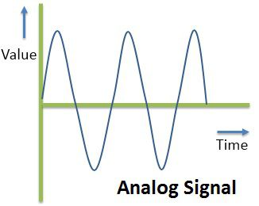
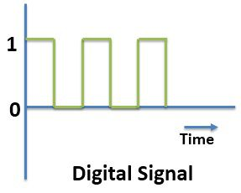
Represented by a continuous function
Represented by a discrete set of values

Slide 3
Advantages of digital signals over analog signals
It is possible to create complex, interactive content
Stored digital signals do not degrade over time or distance as analog signals do
Digital data can be efficiently compressed and transmitted across digital networks
it is easy to store all types of digital media on a common storage medium

Slide 4
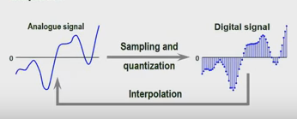
Analog-to-Digital Conversion
*The conversion of signals from analog to digital occurs via two main processes: sampling and quantization
*The reverse process of converting digital signals to analog is known as interpolation

Slide 5
Analog-to-Digital Conversion
Sampling
Conversion from continuous-time, continuous valued signal to discrete-time, continuous-valued signal
Quantization
Conversion from discrete-time, continuous valued signal to discrete-time, discrete-valued signal

